Slide 1
Momentum-Reversal Strategy
Xinjie Huang

Slide 3
Strategy Overview - 1
S&P500 Stock History Data
Inputs
Parameters | Value
start_date: | 2015-01-01
end_date: | 2025-02-25
random_stock_num: | 100
random_seed: | 628
Outputs
Parameters
open price
close price
volume

Slide 4

Strategy Overview - 2
Momentum Calculation
Inputs
Parameters | Value
momentum_lookback: | 13 days*
relative_threshold_lookback: | 252 days
relative_threshold_percent: | 30%*
$$Momentum= \frac{{Close Price}_{t}}{{ClosePrice}_{t−momentum_lookback}}−1$$
Relative Threshold Calculation:
1. Individual Stock Daily Return Data:
 | [-5%, | -1%, | -6%, | 4%, | 3%, | -2%, | 8%, | -7%, | 9%, | 10%]
2. Take absolute value:
 | [-5%, | 1%, | 6%, | 4%, | 3%, | 2%, | 8%, | 7%, | 9%, | 10%]
3. Sort:
 | [-1%, | 2%, | 3%, | 4%, | 5%, | 6%, | 7%, | 8%, | 9%, | 10%]
30th percentile

Slide 5
Strategy Overview - 3.1
Trade
Inputs
Parameters | Value
transaction_fee: | 0.1%
stop_loss_pct: | 5%
vol_risk_multiplier: | 0.8*
reverse_switch: | -1
threshold | -
current_position: | 0
If current_position = -1, and momentum falls into……
[-1, -threshold] current_position = -1 (Turn to short selling) | [threshold, -threshold] current_position = 0 (No position / Close position) | [threshold, 1] current_position = 1 (Turn to buy long)
Hold Short Positions
Close All Short Positions
Close Short Positions
and Go Long

Slide 6

Strategy Overview - 3.2
Trade
Inputs
Parameters | Value
transaction_fee: | 0.1%
stop_loss_pct: | 5%
vol_risk_multiplier: | 0.8*
reverse_switch: | -1
threshold | -
current_position: | 0
reverse_switch: A tall tree catches all of the wind.
Momentum Trading: Following the trend, assuming that "what goes up will continue to rise, and what falls quickly will keep falling."
Reversal Trading: The market tends to reverse after overreacting, so sell when momentum is high and buy when momentum is low.
In case of high trade volume led to fake prosperity on the momentum:
If
$${Volume}_{t}> \frac{\sum_{i=1}^{20}{{Volume}_{t−i}}}{20}×1.5$$
Then
$$Real Daily Trade Return=\text{vol}\text{_}\text{risk}\text{_}\text{multiplier} ×Paper Daily Trade Return$$
Volume MA20

Slide 7
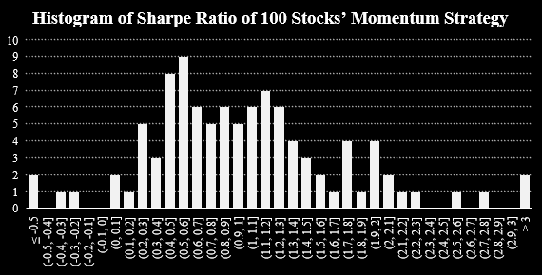
Strategy Overview - 4
Strategy Evaluation & Conclusion
Holding Period: | From 2015-01-01 to 2025-02-25 (~ 10.16 years)
Momentum-Reverse Strategy Average Annual Return | 30.77%
Passive Strategy Average Annual Return | 9.79%
Average Annual Excess Return | 20.98%
(Benchmark) S&P 500 Average Annual Return | 11.08%
ERP | 8.57%
Win Rate | 75.00%
Among 100 Stocks, strategy win rate has reached 75%
Average annual excess return reached 20.98%
Mean: 1.0

